Slide 1
Speech signal, Features and Noise

Slide 2
Section 1
Sound and Signal
Quantization and Sampling

Slide 3
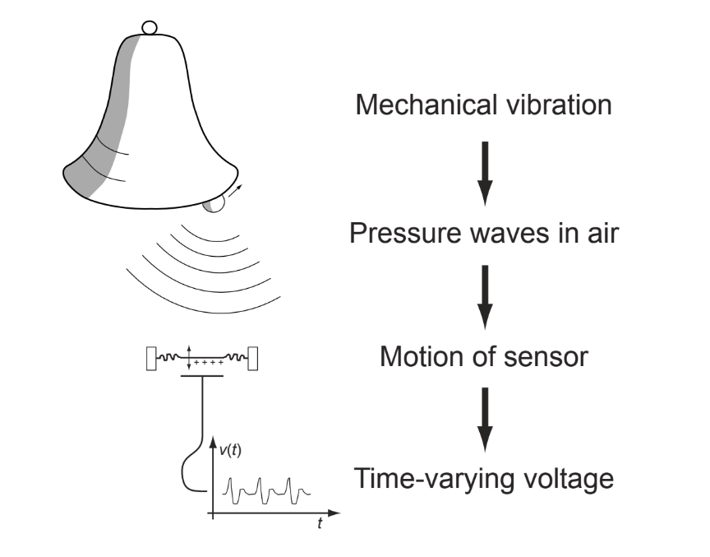
Sound and Signal
Sound is air pressure variation.
Waves travelling through air, and so treated as signals.
Notes:
Adapted from L01 page 3 of Dan's slides

Slide 4
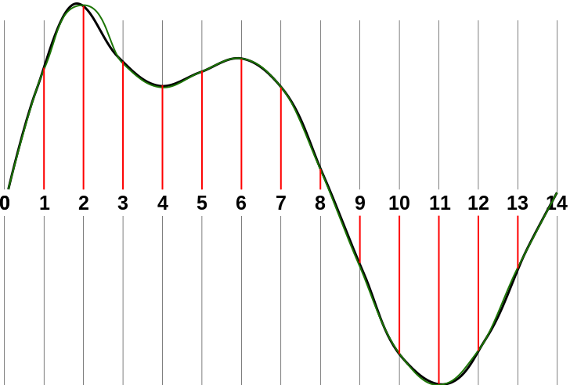
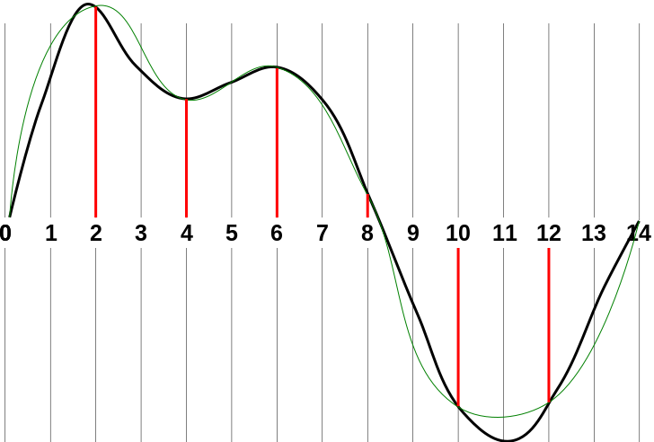
Recording the sound, Sampling
Sound signal is sampled at regular intervals (at sampling frequency) and the value of the amplitude at that moment of signal is observed.
Sampling rate: 44.1 kHz for audio and human speech recording 16kHz.
Notes:
Image source: https://en.wikibooks.org/wiki/A-level_Computing/AQA/Problem_Solving,_Programming,_Data_Representation_and_Practical_Exercise/Fundamentals_of_Data_Representation/Sampled_sound

Slide 5
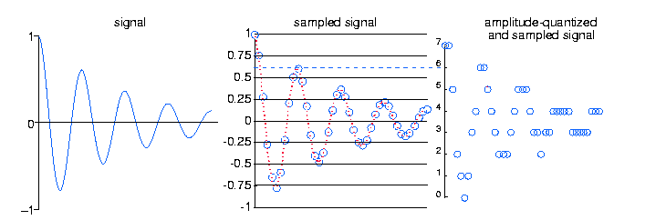
Quantization
Observed amplitudes are quantized. Only quantized values are stored.
Notes:
Image source: https://archive.cnx.org/contents/bf483620-7240-4f43-8551-d95696257711@25/amplitude-quantization

Slide 6
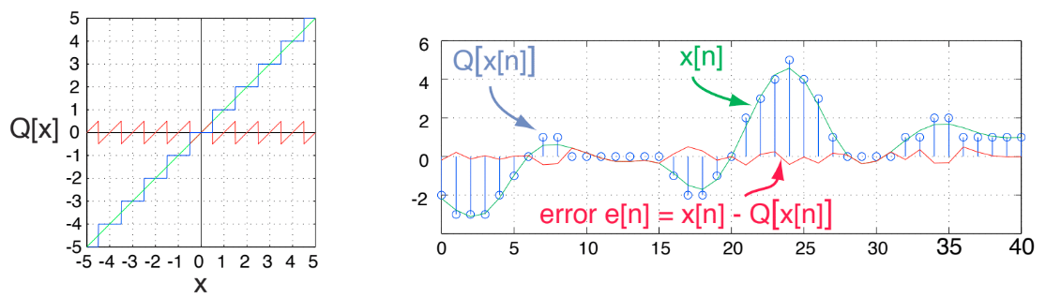

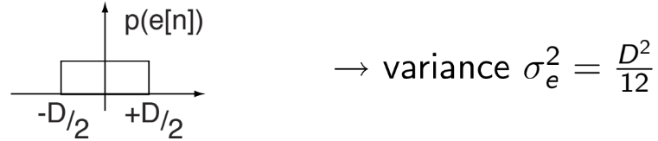
Quantization Cont.
Represent waveform with discrete levels.
Equivalent to adding error e[n]:
e[n] ~ uncorrelated, white noise
Notes:
Adapted from L07 page 6 of Dan's slides

Slide 7
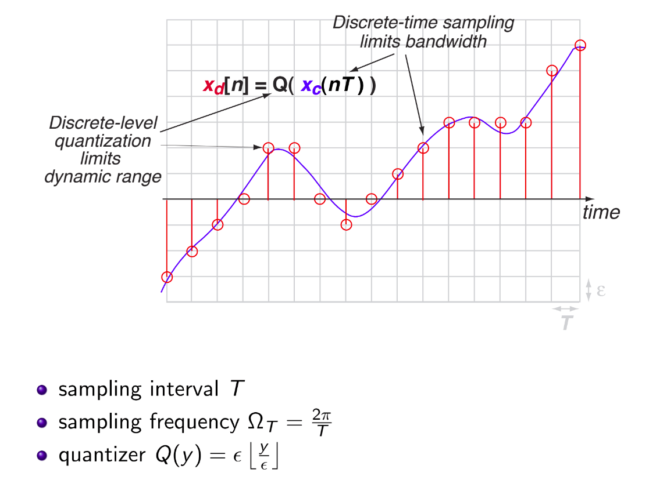
Sampling and Quantization together
Notes:
Adapted from L01 page 16 of Dan's slides

Slide 8
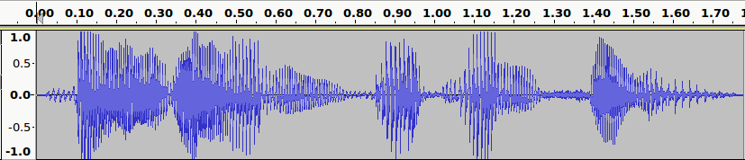
How the waveform looks ...
"Buy one, get one free!"

Slide 9
Section 2
Features from audio
2.1 Fourier Transform and Spectrogram
2.2 MFCC
2.3 Constant Q Transform and Q-Spectrogram
2.4 Wavelet Transform and Scalogram

Slide 10
Features
To work with the audio for classification and for many other tasks we need to extract features out of the audio.
Here we study a few common features:
MFCC
Spectrogram
Scalogram
Q-Transform Spectrogram
We need to understand the Fourier, Wavelet and Q Transform, to understand the features.

Slide 11
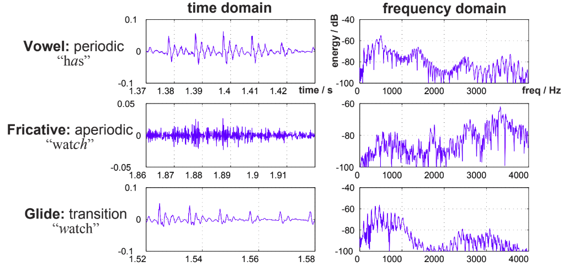
2.1 Fourier Transform
Idea: Break the signal into a combination of simple signals (sines and cosines) with different frequencies. Find out how much energy does each frequency contribute.
Notes:
Adapted from L01 page 24 of Dan's slides

Slide 12
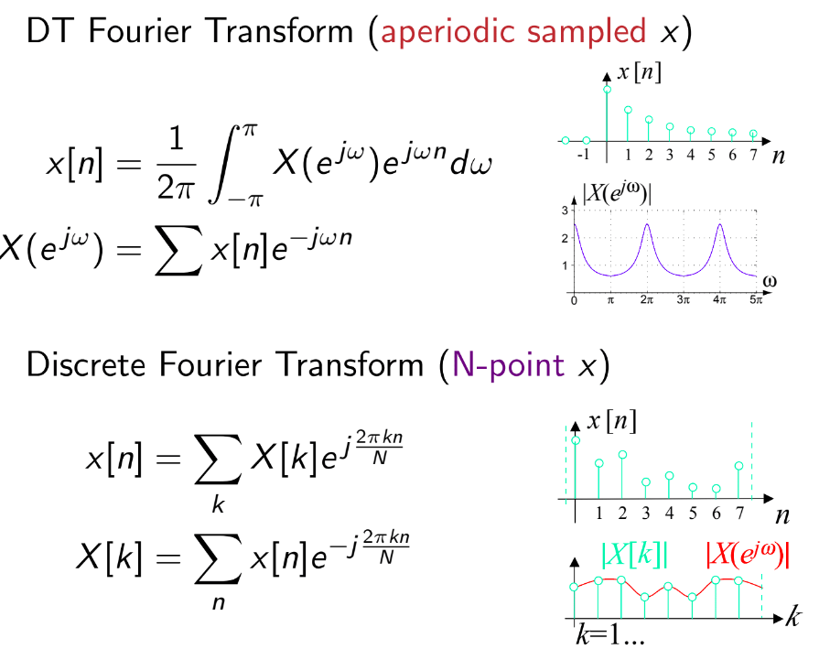
Discrete-time Fourier
Notes:
Adapted from L01 page 22 of Dan's slides

Slide 13
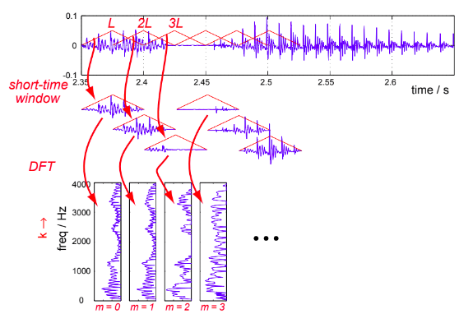
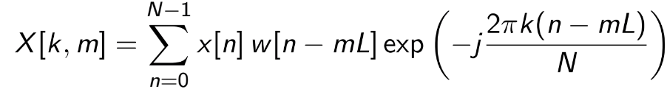
Short Term Fourier transform (STFT)
Want to localize energy in time and frequency.
Break sound into short-time pieces
Calculate DFT on each one
Mathematically,
Notes:
Adapted from L01 page 25 of Dan's slides

Slide 14
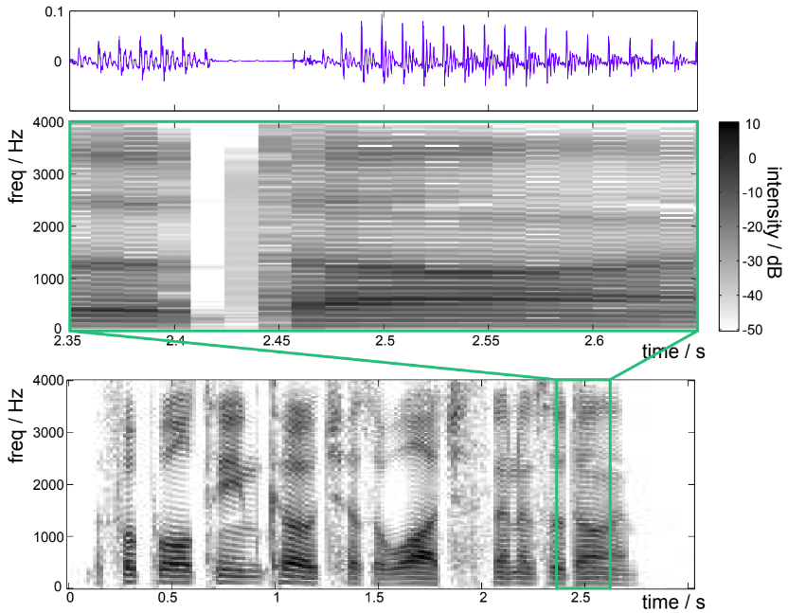
The Spectrogram
Plot STFT X[k, m] as an image.
Notes:
Adapted from L01 page 26 of Dan's slides

Slide 15
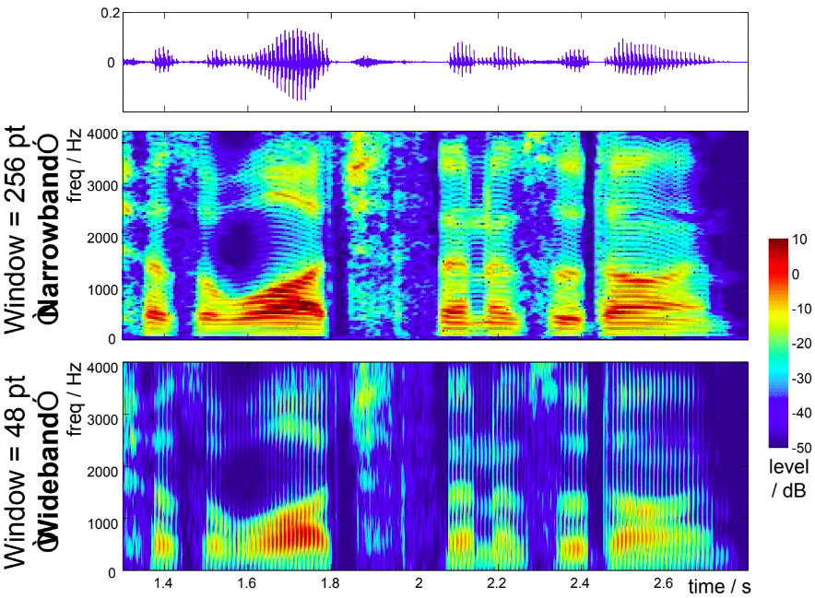
Time-frequency Tradeoff
Longer window w[n] gains frequency resolution at the cost of time resolution.
Notes:
Adapted from L01 page 27 of Dan's slides

Slide 16
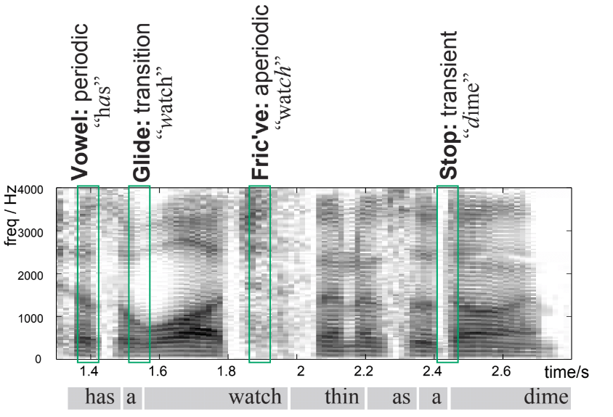
Speech sounds on the spectrogram
Most popular speech visualization.
Notes:
Adapted from L01 page 28 of Dan's slides

Slide 17
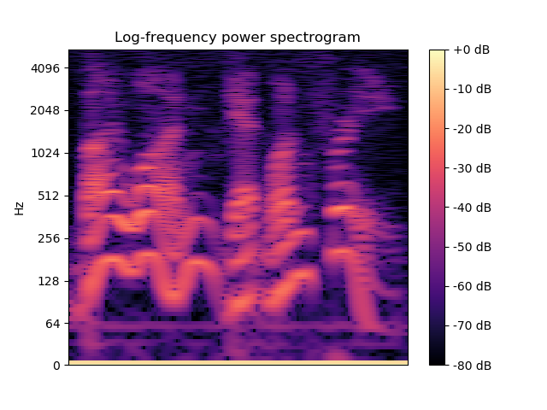
Sample Spectrogram
"Buy one, get one free!"
Often the features are plotted on a logarithmic scale of frequencies.
This is because our ears detect logarithmically rather than linearly.

Slide 18
2.2 Filter Bank Coefficients
The spectral magnitudes produced by the Short Time Fourier Transform contains too much information for subsequent processing/analysis.
Filter bank coefficients are a more compact representation of the spectral magnitudes.
It consists of a series (bank) of bandpass filters (typically triangular filters) and each bandpass filter produces one coefficient corresponding to the sum of the bandpassed signal.
Notes:
Adapted from lecture 4 , page 7 NUS slides

Slide 19
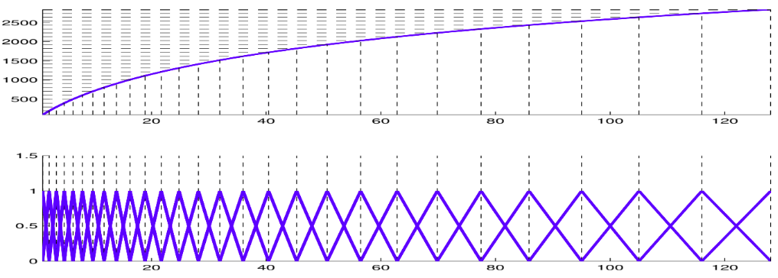
Mel Filter Bank Coefficients
Mel scale is a perceptual scale of pitches judged by listeners to be equal in distance from one another.
The Mel function is a non-linear mapping between the frequency and the Mel scales:
Points equal distance apart in the Mel has a higher resolution at the lower frequencies
Notes:
Adapted from lecture 4 , page 8 NUS slides

Slide 20
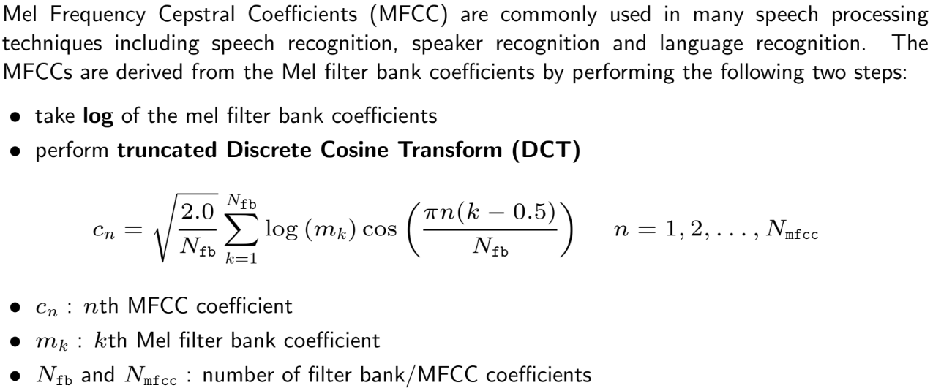
Mel Frequency Cepstral Coefficients (MFCC)
P. Mermelstein (1976), "Distance measures for speech recognition, psychological and instrumental."
Notes:
Adapted from lecture 4 , page 9 NUS slides

Slide 21
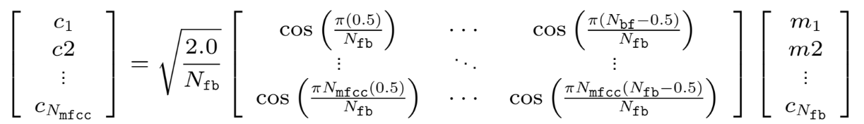
Discrete Cosine Transform (DCT)
The DCT formula can be written as linear transformation in a matrix form:
Notes:
Adapted from lecture 4 , page 10 NUS slides

Slide 22
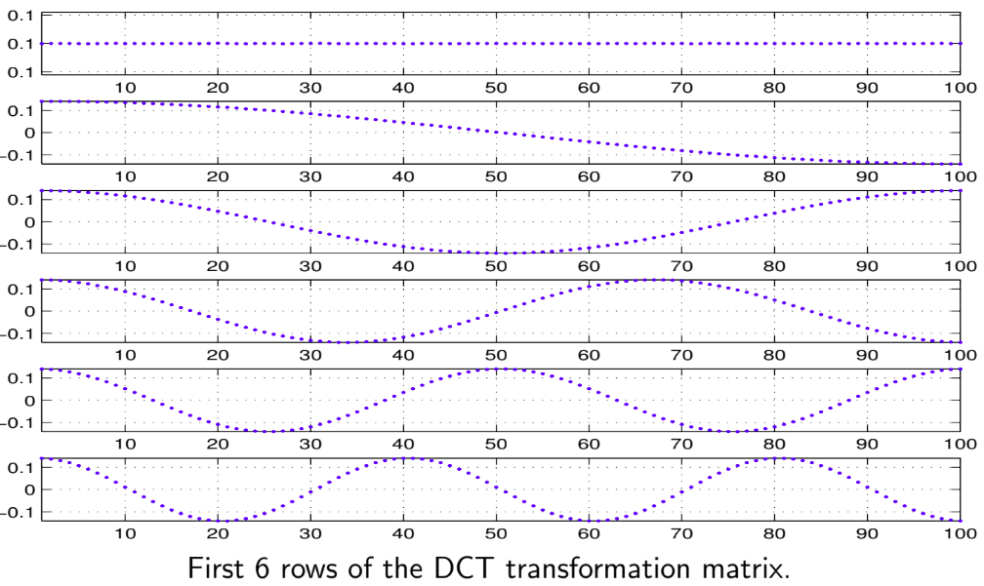
Basic Functions of DCT

Slide 23
2.3 Limitations of STFT and the Constant Q Transform (CQT)
The resolution of the windowing function w[] in the standard STFT is the same for all values of the frequency.
Further, the standard STFT has equally spaced frequencies because the exponent increases linearly.
To treat high and low frequencies "equally" we need to:
have bin widths that are equal in octaves, not in absolute frequencies
space the frequencies in the spectrum logarithmically
These are achieved by Constant Q transform.
Notes:
Source: https://www.edn.com/electronics-blogs/sound-bites/4421452/Audio-pitch-shifting---the-constant-Q-transform

Slide 24

Constant Q Transform (CQT)
CQT modifies the STFT such that the frequency bins are logarithmically spaced.
The windowing function is adjusted with center frequency so that the width of each bin too increases in proportion to the center frequency.
The ratio of ω/δω is kept constant, hence the term “Constant-Q”. (ω: frequency).
Ignoring a normalization term, the transform now looks like this:
Judith C. Brown, "Calculation of a constant Q spectral transform"
Notes:
Source: https://www.edn.com/electronics-blogs/sound-bites/4421452/Audio-pitch-shifting---the-constant-Q-transform

Slide 25
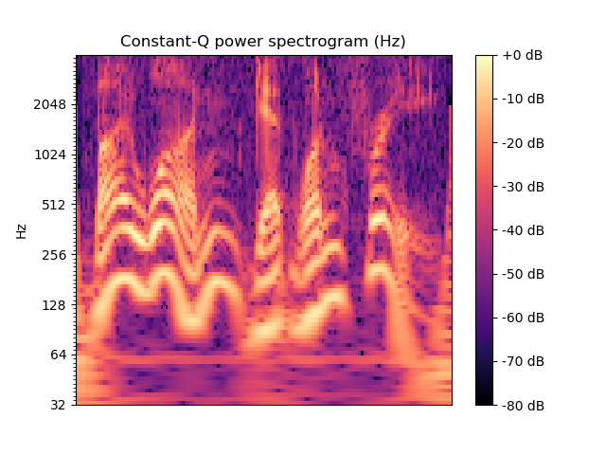
CQT Spectrogram
Similar to STFT, we plot the values from CQT and obtain the CQT Spectrogram.
For the same audio "Buy one, get one free!"
Notes:
Image created locally using librosa on cmu_a0001.wav.

Slide 26
CQT Spectrogram Applications
Mirrors the human auditory system, at lower-frequencies spectral resolution is better, whereas temporal resolution improves at higher frequencies.
It is more suited than spectrogram for musical data.
More useful when the frequencies span multiple octaves as fewer frequency bins are required to cover a given range effectively.
Notes:
Source: https://en.wikipedia.org/wiki/Constant-Q_transform

Slide 27
2.4 Wavelet Transform (Continuous)
CWT is used to divide a continuous time function into wavelets.
A wavelet is a brief wave-like oscillation which satisfies certain mathematical properties.
For CWT we first choose a 'mother' wavelet.
This wavelet is scaled and shifted to generate different functions.
These functions are convolved with the input signal to obtain the CWT.
Like spectrogram is for Fourier transform, the plot of CWT is called scalogram.
Notes:
Content source: https://en.wikipedia.org/wiki/Continuous_wavelet_transform and https://en.wikipedia.org/wiki/Wavelet

Slide 28
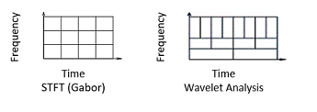
CWT cont.
Fourier transform gives a frequency representation of the signal while CWT gives a time-frequency representation.
CWT offers both time and frequency localization.
Lower frequencies get a wider time window and higher frequencies get shorter time window in the scalogram.
This can be seen by comparing the frequency-time divisions in the spectrogram and scalogram.
Notes:
Image source: https://www.mathworks.com/help/wavelet/gs/continuous-wavelet-transform-and-scale-based-analysis.html

Slide 29
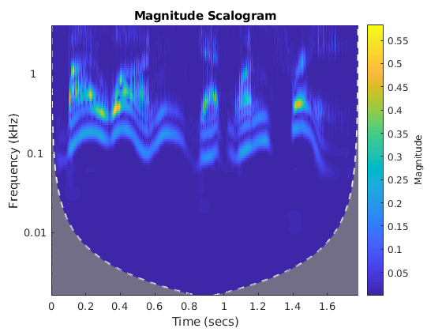
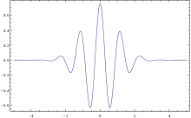
Scalogram
Morlet Wavelet and corresponding scalogram for "Buy one, get one free!"
Notes:
Morlet wavelet image source: https://en.wikipedia.org/wiki/Wavelet
Scalogram created locally in MATLAB using cwt funciton.

Slide 30
Section 3
Noise and its types
Effects on the features

Slide 31
3.1 NOISE
Noise is an unwanted disturbance present in the signal.
Arises during transmitting, capturing or conversion of signals.
The common types of noise are :
1. White noise
2. Black noise
3. Gaussian noise
4. Pink noise
5. Brown noise

Slide 32

Signal-to-noise (SNR) is the ratio of signal power to noise power. It is often expressed in decibels.
Where A is the root mean square amplitude.
Noise is more robust in high-frequency range as compared to low-frequency range.

Slide 33
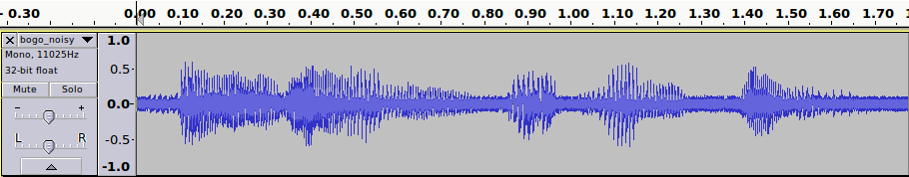
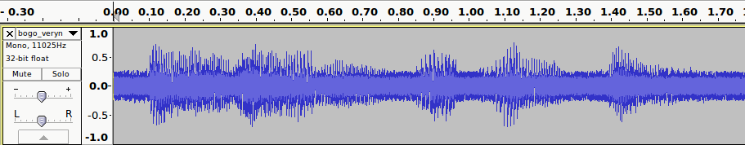
Waveform, with noise
The waveform of "Buy one get one free!" with little noise.
The same waveform with much larger noise.

Slide 34
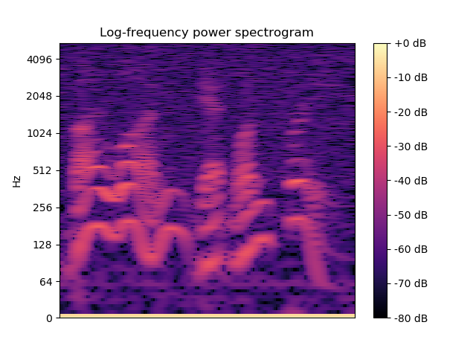
3.2 EFFECT OF NOISE
The presence of noise in signals affects the feature representation in the following ways.
1. Spectrogram ("Buy one get one free!" without and with little noise)
Without noise With little noise

Slide 35
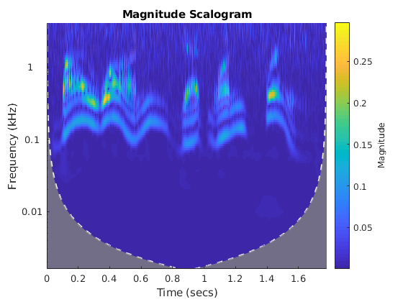
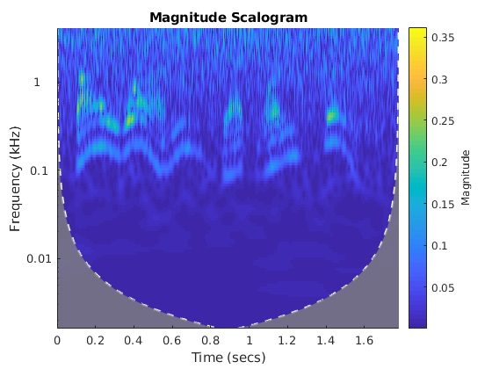
2. Scalogram:
CWT is more resistant against noise, and hence does not show much change with little noise.
"Buy one get one free!" without and with little and high noise.
Without noise with little noise with high noise
Notes:
CWT is known to be more robust against noise. Refer to https://en.wikipedia.org/wiki/Continuous_wavelet_transform reference 5.

Slide 36
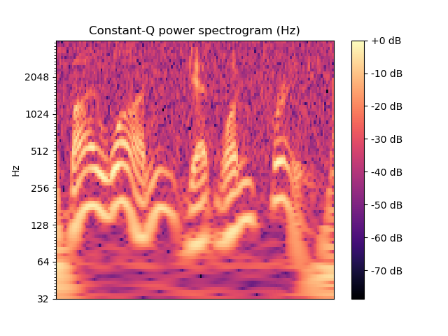
3. Q Spectrogram:
"Buy one get one free!" without and with little noise.
Without noise with noise
Notes:
CWT is known to be more robust against noise. Refer to https://en.wikipedia.org/wiki/Continuous_wavelet_transform reference 5.

Slide 37
4. MFCC Features
Presence of noise also affects the MFCC features.
The distance between the MFCC feature vector of the pure signal and noisy signal depends upon the variance in the noise present.

